Slide 1



TEAM DATA JAMMERS
FINAL ROUND
A comprehensive design model for Hyderabad Waste Collection Route Optimization
GHMC VEHICLE ROUTING SYSTEM

Slide 2

TEAM DATA JAMMERS
FINAL ROUND
THE CHALLENGE
1,581 garbage points → Only 18 transfer stations
Vehicles traveling unpredictable routes
Waste overflow in some areas, underused trucks in others
No systematic planning for 1349 units of daily waste

Slide 3
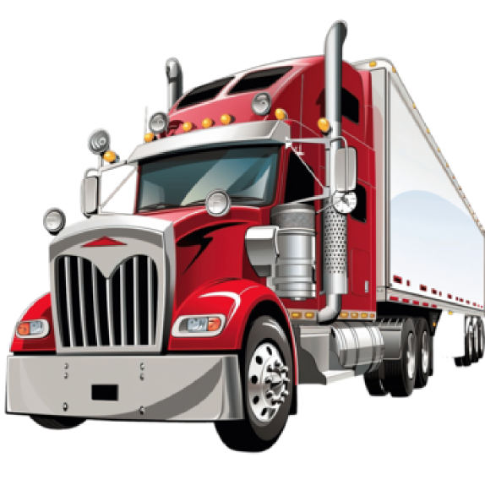

TEAM DATA JAMMERS
FINAL ROUND
HOW WE WORKED THROUGH?

Slide 4
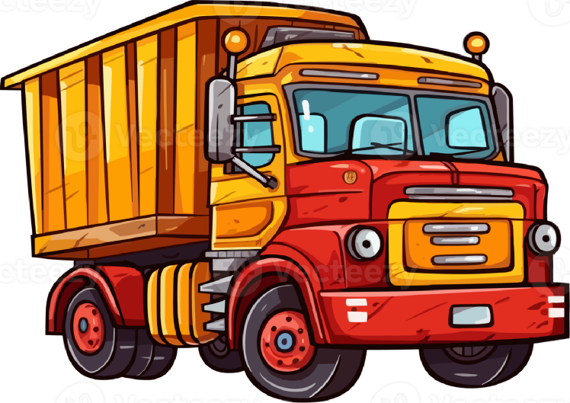

METHODOLOGICAL TIMELINE
PHASE-01
PHASE-02
PHASE-03
PHASE-04
DATA CLEANING
DATA TRANSFORMATION
DISTANCE ANALYSIS
ROUTE OPTIMIZATION
Inconsistencies removed to ensure clean, reliable foundational data.
Raw data reshaped into analysis-ready intelligence.
Structured transformations enabled efficient and meaningful analysis.
Insights converted into optimized, decision-ready outcomes.
FINAL ROUND

Slide 5

TEAM DATA JAMMERS
FINAL ROUND
TOP 03 KEY METRICS
Vehicle Allocation
Route Optimization
Scheduling Efficiency Metrics

Slide 6
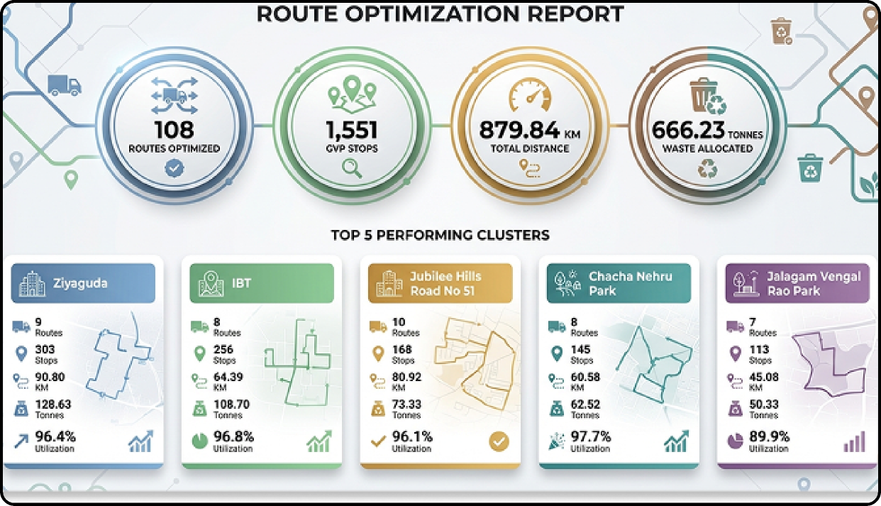
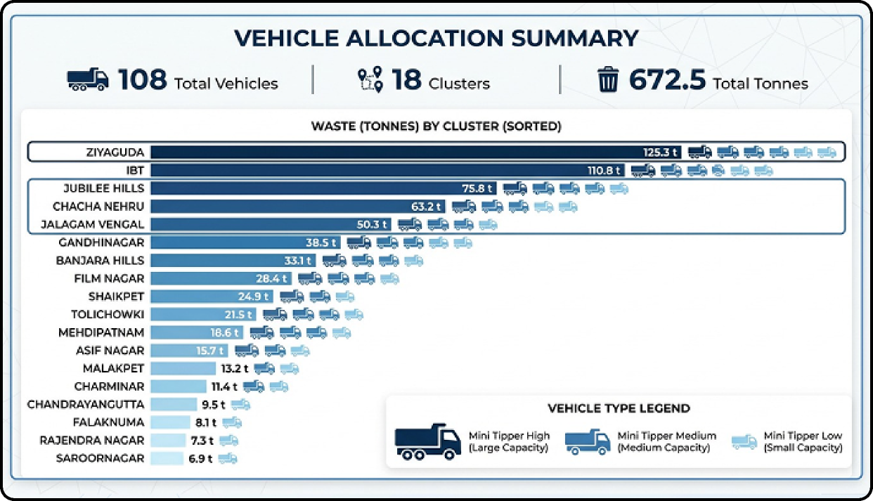
TEAM DATA JAMMERS
FINAL ROUND
"RIGHT VEHICLE”

Slide 7
TEAM DATA JAMMERS
FINAL ROUND
“RIGHT PLACE”

Slide 8
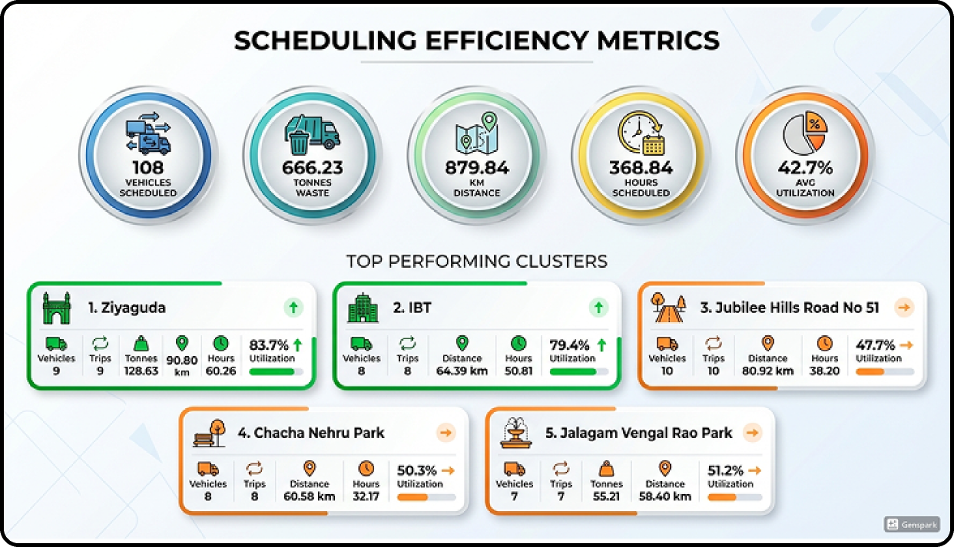
TEAM DATA JAMMERS
FINAL ROUND
“RIGHT TIME"

Slide 9
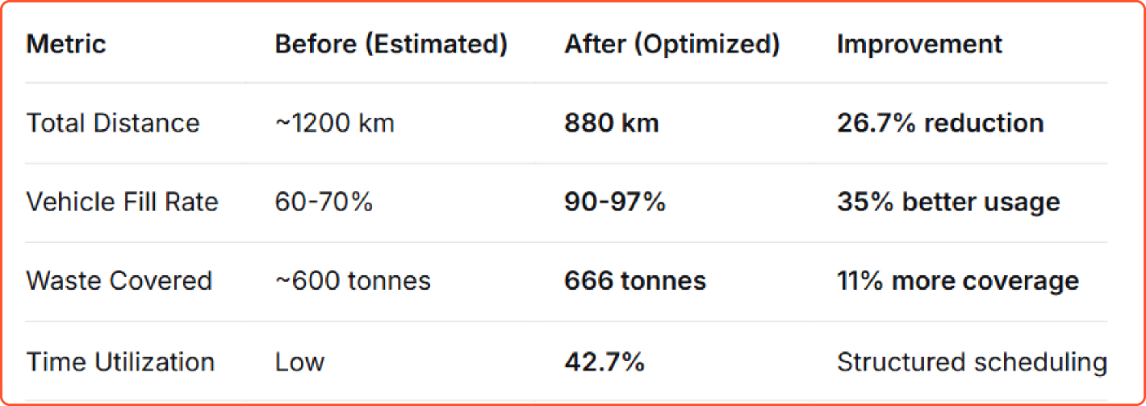

TEAM DATA JAMMERS
FINAL ROUND
Before vs After Comparison SUMMARY:
--------------------------------------------
(The Number speaks for itself)

Slide 10


TEAM DATA JAMMERS
FINAL ROUND
FFROM ONE YEAR FROM NOW
"OUR GRAND VISION FOR HYDERABAD'S WASTE MANAGEMENT."
BY JANANI V & KAMALRAAJ SENTHILKUMAR

Slide 11
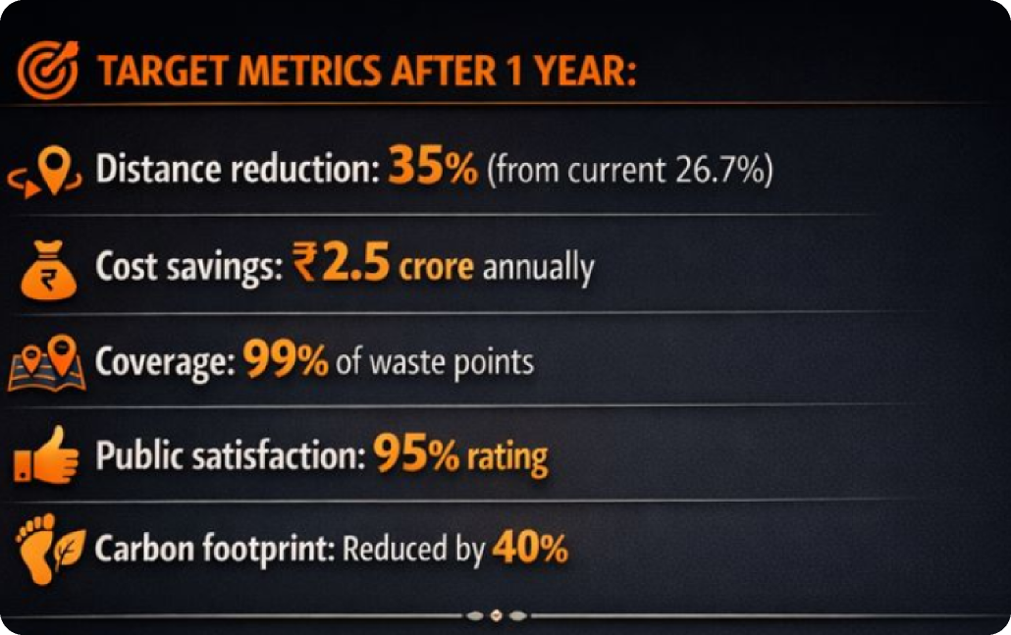
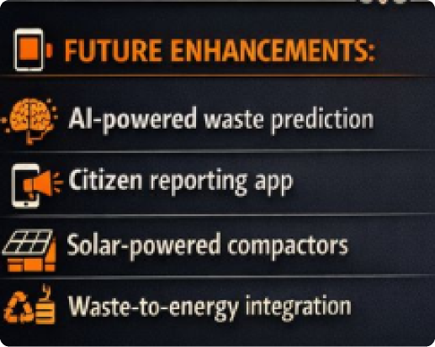

TEAM DATA JAMMERS
CAPTION
FINAL ROUND
CLEAN DATA + SMART CLUSTERING + RIGHT VEHICLES + OPTIMIZED ROUTES
= MAXIMUM WASTE COLLECTED WITH MINIMUM RESOURCES

Slide 12
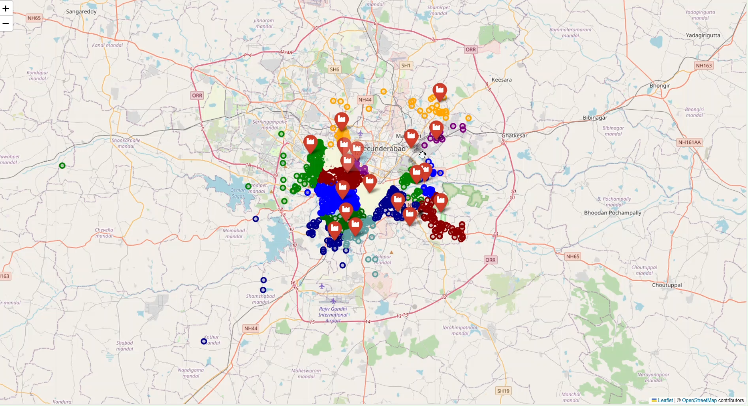
THANK YOU IITH & GHMC :)

